Slide 1


GARMENT WORKER PERFORMANCE
Akinlade Rereloluwa
Sheetal Dighe
Yalamanchi Sreedweep Sharma
B.lalitha saipravallika

Slide 2
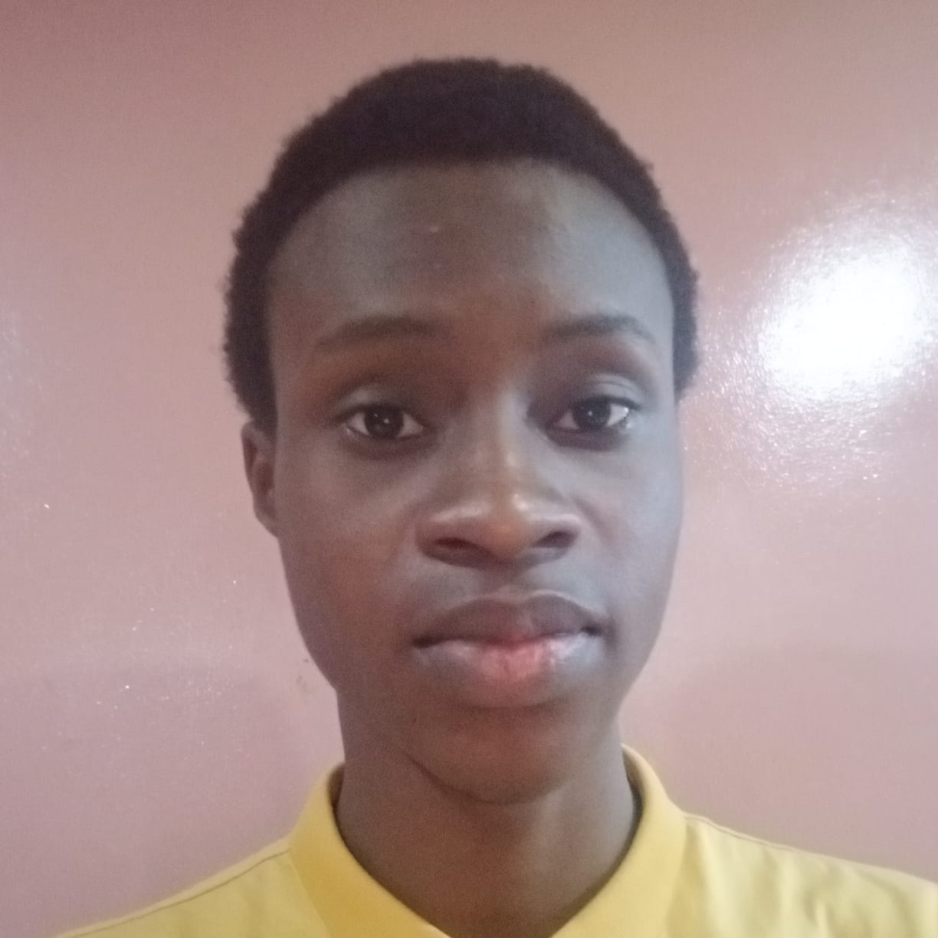



The team
Akinlade Rereloluwa
Yalamanchi Sreedweep Sharma
B.lalitha sai
Pravallika
Sheetal Dighe
Bowen University ,lwo, Nigeria
Gyansadhana College Thane
Smt.a.shymala Devi Degree College for women
Sreenidhi institute of science and technology

Slide 3

Background
The Garment Industry is one of the key examples of the industrial globalization of this modern era.
It is a highly labour-intensive industry with lots of manual processes.
Satisfying the huge global demand for garment products is mostly dependent on the production and delivery performance of the employees in the garment manufacturing companies
It is highly desirable among the decision makers in the garments industry to track, analyse and predict the productivity performance of the working teams in their factories.

Slide 4
Project Objective
About Data
This dataset includes important attributes of the garment manufacturing process and the productivity of the employees which had been collected manually and also been validated by the industry experts.
Objective:
The regression goal is to predict the productivity of garment workers
Path:
Implementing Multiple machine learning models to fit the best model for the data set.

Slide 5
About Data
A total of 1197 rows of data, bearing information for 15 columns
Column Name | Column Description
no_of_workers | Number of workers in each team 07
targeted_productivity | Targeted productivity set by the Authority for each team for each day.
smv | Standard Minute Value, it is the allocated time for a task
wip | Work in progress. Includes the number of unfinished items for products
over_time | Represents the amount of overtime by each team in minutes
incentive | Represents the amount of financial incentives (in BDT) that enables or motivates particular course of action
idle_time | The amount of time when the production was interrupted due to several reasons
actual_productivity | The actual % of productivity that was delivered by the workers. It ranges from 0-1

Slide 6
Machine Learning Analysis Timeline
Data Preprocessing
Determining Model Accuracy
Summary and Recommendation
Exploratory Data Analysis
Comparing results with other models
1 |  | 2 |  |  | 3 | 4 |  |  | 5

Slide 7
Data Preprocessing
Missing Values: 506 for column WIP (Work In Progress)
The “WIP” had NAN values, so we filled it with the median
Changed the Date columns to Real Date time Object
Renamed the “WIP” column to work_in_progress and the “SMV” to standard_minute_value for better readability.
Changed the categorical values of columns quarter and days to numerical values by using dummy variable encoding
Department Column had one of its element with wrong spelling - changed the spelling of “SWEING” to “SEWING”
Dropped Columns: “quarter” and “date” as they were not significant

Slide 8
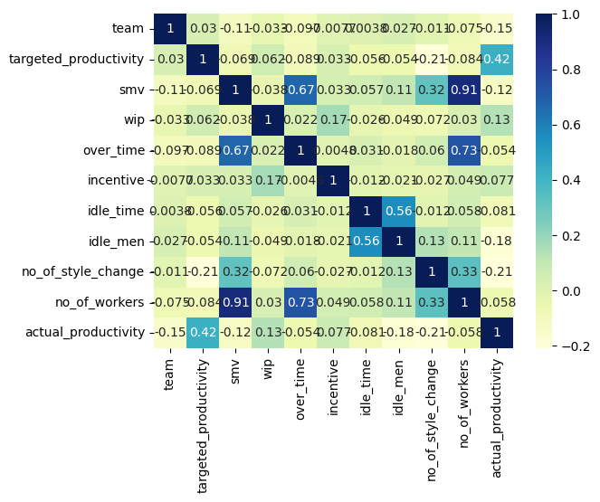
Exploratory Data Analysis
The Heat map shows the correlation between different columns.
We can see that there is a strong positive correlation between no. of workers and SMV (allocated time for task) column.
Even no. of workers and over time columns are highly correlated.

Slide 9
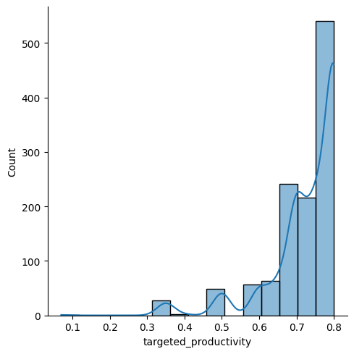
Exploratory Data Analysis
From the observed histogram we can say that data for targeted productivity is left skewed.

Slide 10
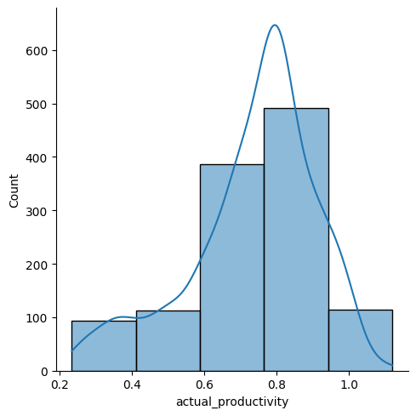
From the observed histogram we can say that data for actual productivity is normally distributed.

Slide 11
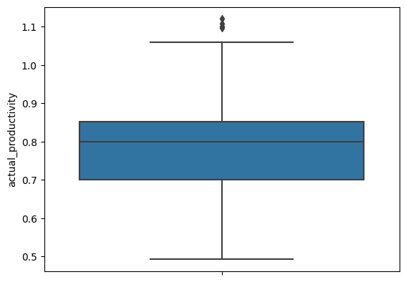
From the observed box plot, we can say that the data above the maximum limit are the outliers.

Slide 12
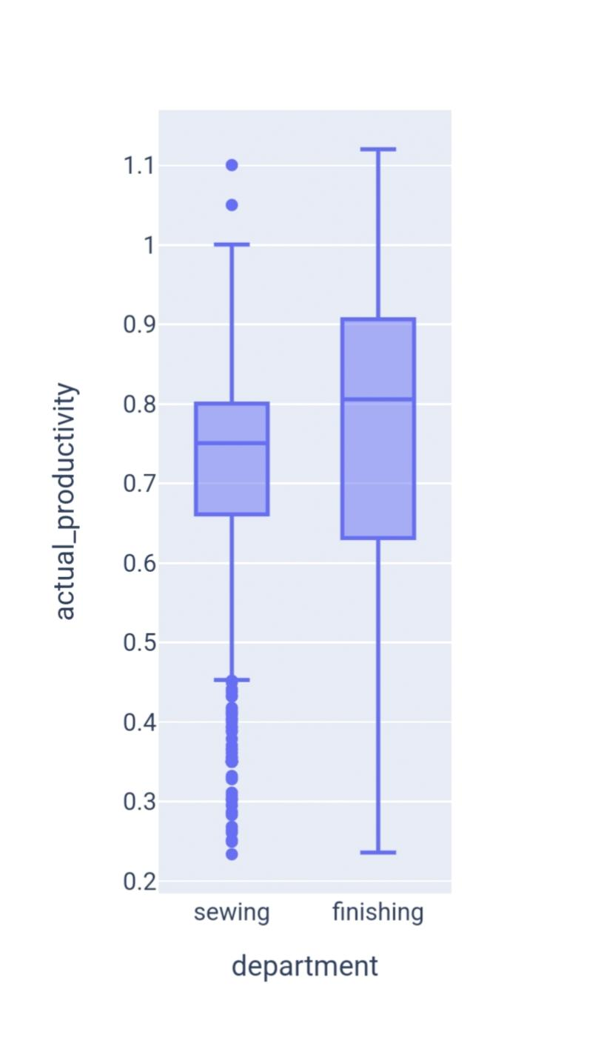
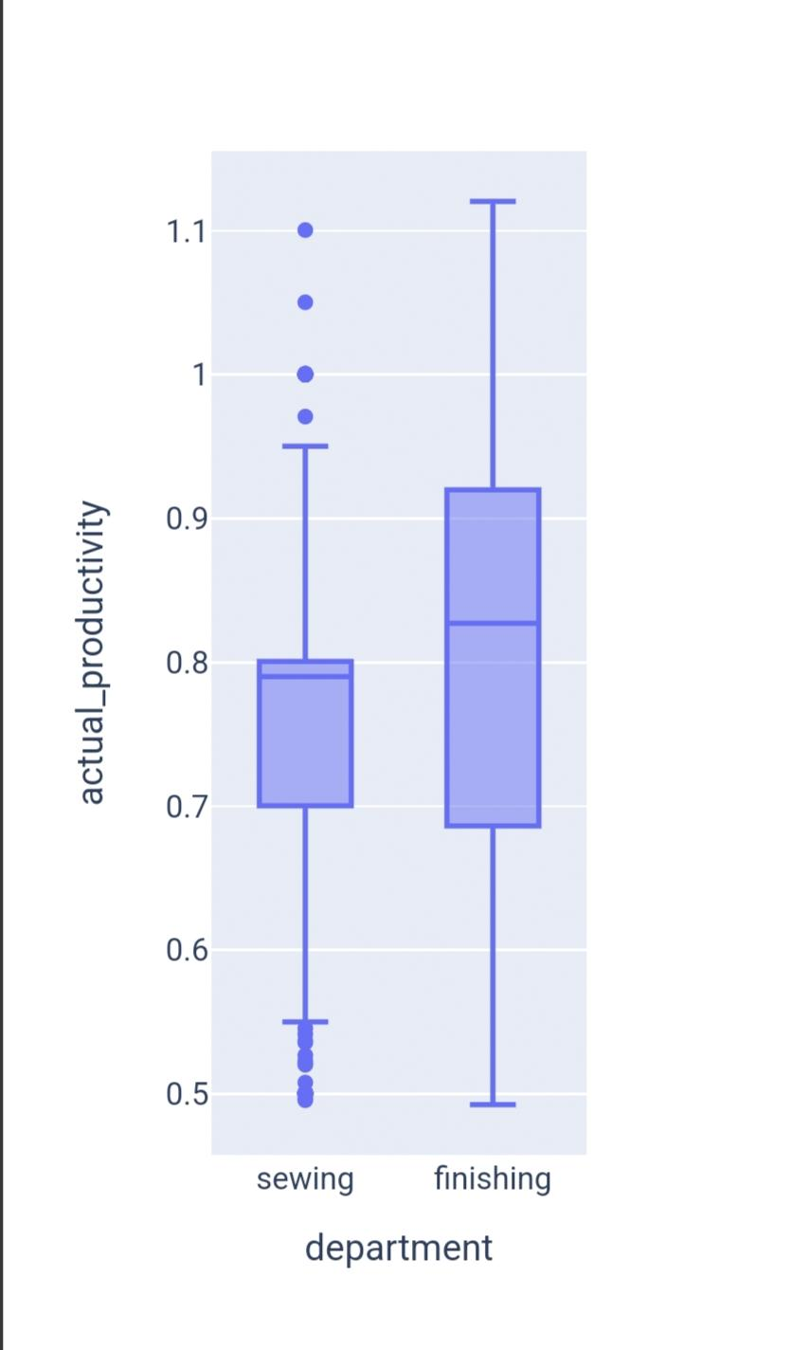
This plotly chart gives us a better view of the outliers in the column department and we removed 11.76% of the outlier.
This is the outcome from the outlier removed plotted as we see , the outlier is limited, we could not remove all due to less amount of Data.

Slide 13
Machine Learning Algorithms
Linear Regression
Decision Tree
Random Forest
K Nearest Neighbor
Support Vector Machine

Slide 14
Linear Regression
Train-Test Ratio | Mean Absolute Error
80-20 | 0.10509
75-25 | 0.11187
70-30 | 0.11239
65-35 | 0.10975
In the evaluation of the linear regressor for different train and test ratios ,the 80-20 split gives minimum Mean Absolute Error .It indicates that the 80:20 gives the best predictive performance for the model.

Slide 15
Decision Tree
Train-Test Ratio | MeanAbsoluteError
80-20 | 0.08615
75-25 | 0.08192
70-30 | 0.08381
65-35 | 0.10244
In the evaluation of the Decision Tree regressor for different train and test ratios ,the 75:25 split gives minimum Mean Absolute Error .It indicates that the 75:25 gives the best predictive performance for the model.

Slide 16
Random Forest
Train-Test Ratio | MeanAbsoluteError
80-20 | 0.07750
75-25 | 0.08101
70-30 | 0.07696
65-35 | 0.07831
In the evaluation of the Random Forest regressor for different train and test ratios the 70-30 split gives minimum Mean Absolute Error. It indicates that the 70:30 gives the best predictive performance for the model.

Slide 17
K-Nearest Neighbor Regressor
Train-Test Ratio | MeanAbsoluteError
80-20 | 0.13423
75-25 | 0.12371
70-30 | 0.12679
65-35 | 0.11936
In the evaluation of the K-nearest Neighbor regressor for different train and test ratios ,the 65-35 split gives minimum Mean Absolute Error .It indicates that the 65:35 gives the best predictive performance for the model.

Slide 18
Support Vector Machine
Train-Test Ratio | MeanAbsoluteError
80-20 | 0.13120
75-25 | 0.13941
70-30 | 0.12997
65-35 | 0.13229
In the evaluation of the Support Vector Machine regressor for different train and test ratios, the 70-30 split gives minimum Mean Absolute Error . It indicates that the 70:30 gives the best predictive performance for the model.

Slide 19
0.07696344488093637 Comparison of Implemented Models
Machine Learning Model | Train-Test Ratio | MeanAbsoluteError
Linear Regression | 80-20 | 0.10509
Decision Tree | 75-25 | 0.08192
Random Forest | 70-30 | 0.07696
K-Nearest Neighbor | 75-25 | 0.11936
SupportVectorMachine | 75-25 | 0.12997

Slide 20
Summary and Recommendation
For the Garment Worker Performance data set ,we performed five types of machine learning algorithms namely Linear Regression, Decision Tree, Random Forest , K-Nearest Neighbor and Support Vector Machine
From the analysis and implementation of the algorithms we found best result in Random Forest Algorithm for the train-test ratio 70-30 with least mean absolute error as 0.07696
So, we can conclude that Random Forest Algorithm model is the best model for Garment worker performance dataset.

Slide 21
Insights
Ways to improve the Productivity –
Increasing incentives
Increasing the time allocated to complete a task i.e., SMV
What can be done to further improve this analysis –
Using a larger dataset
Applying Hyperparameter tuning like Grid search, Random search
Using Boosting model

Slide 22

THANK YOU
THANK YOU
Akinlade Rereloluwa
Sheetal Dighe
Yalamanchi Sreedweep Sharma
B.lalitha sai pravallika

Slide 23
APPENDIX

Slide 24
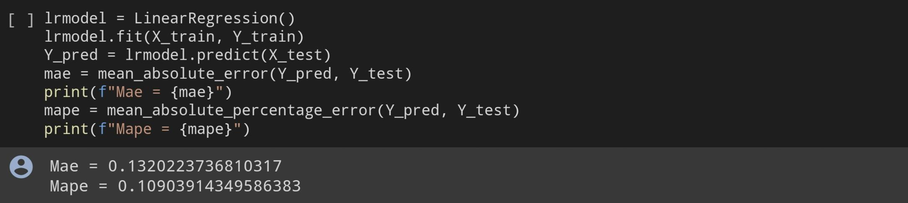
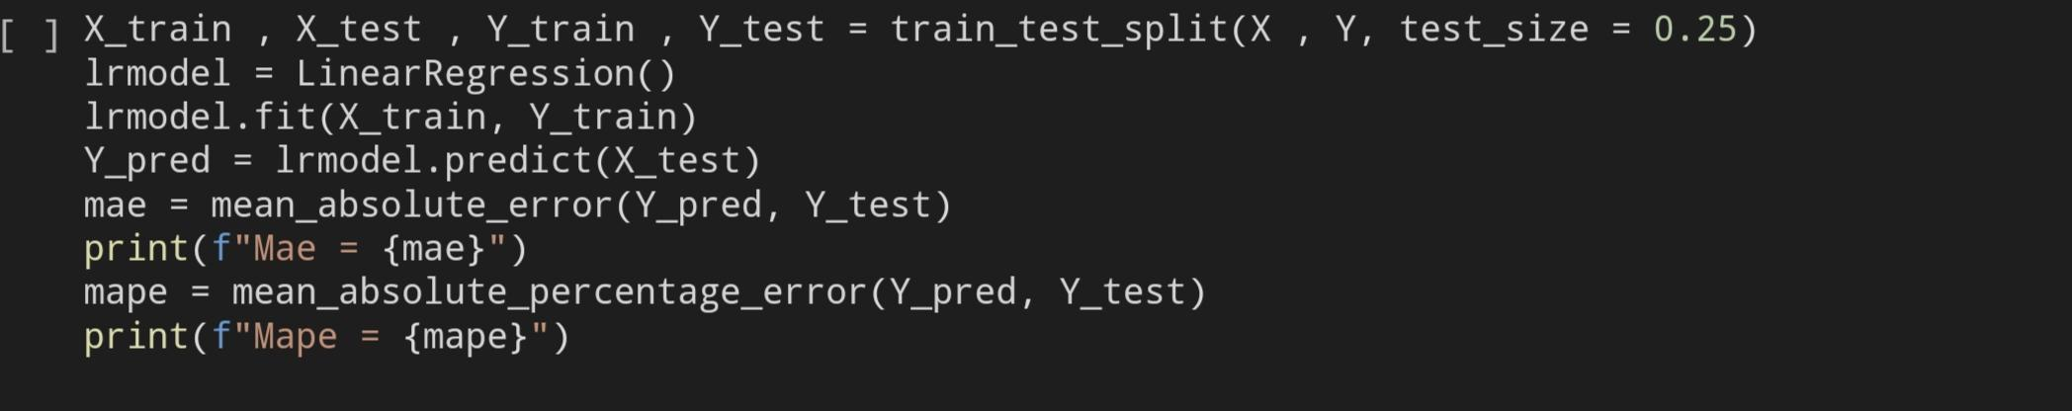
Linear regression

Slide 25
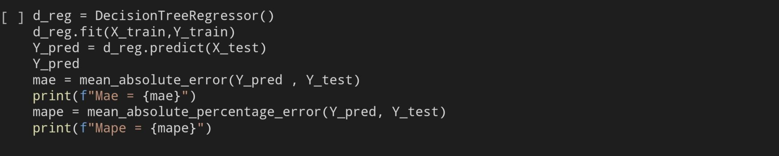
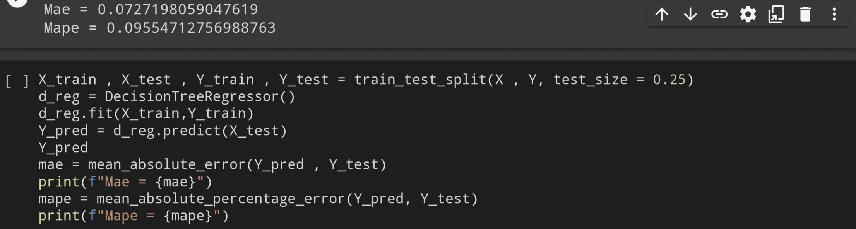
Random forest regression

Slide 26
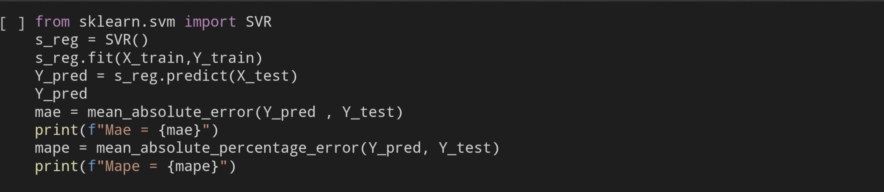
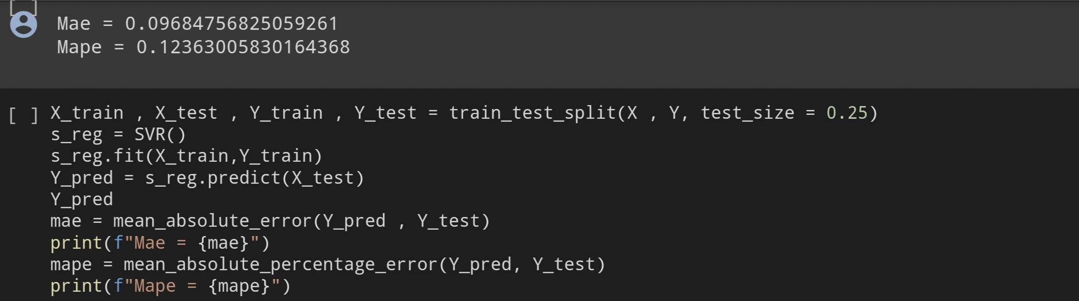
Support vector regressor

Slide 27
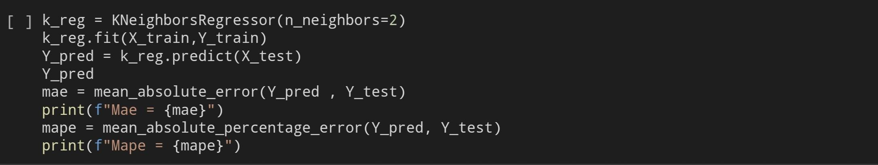
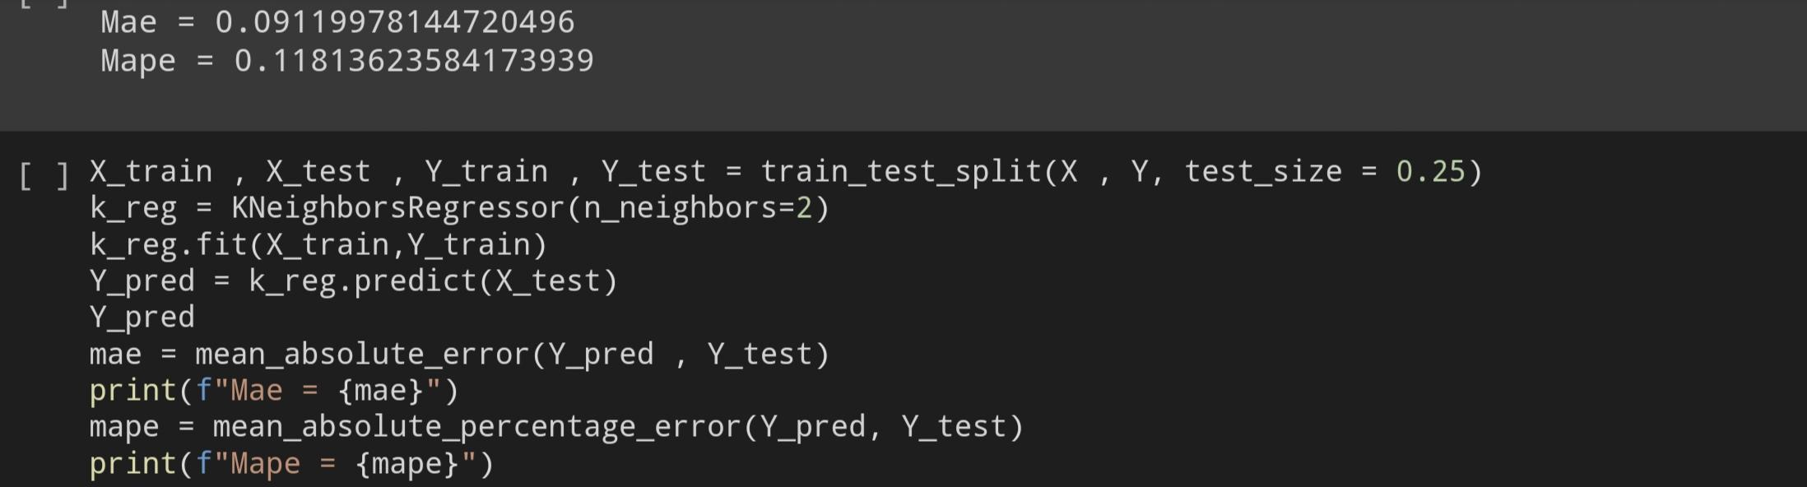
KNeighbors regressor

